Slide 1
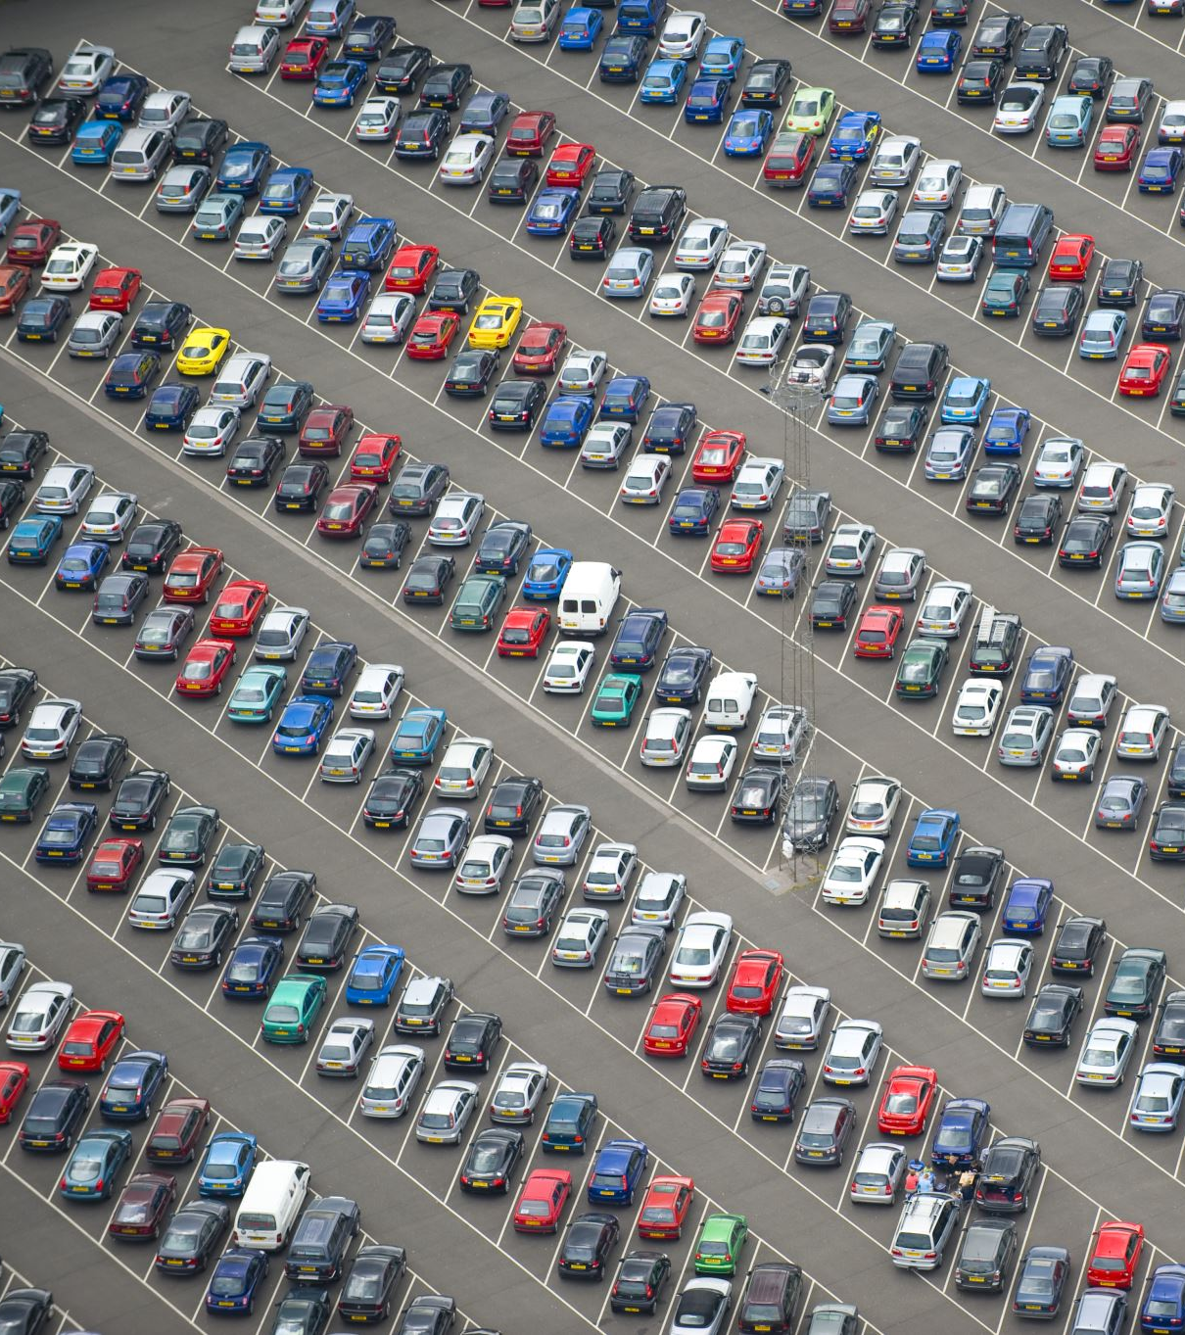
Lariat Rental Car Project
By: Jason Westfall
Notes:
- Brief Introduction (Hi, I’m Jason Westfall. I will be doing a presentation about what the Lariat Rental Car Company can do to increase its revenue.

Slide 2
Overview
Problem
Different Strategies
Best Strategy
Notes:
This presentation will cover the problem and give a baseline projection on where things currently stand.
Next, I will describe different strategies on how to address this problem (five overall)
- After each strategy is addressed, I will give a recommendation on which strategy would be best to meet the objective

Slide 3
Problem / Baseline
Notes:
Chart shows Bottom 10 Rental Vehicles in regard to net profit. 2018 Daewoo Nubira is the worst on the list with a net loss of $3,271. That one vehicle in the inventory only grossed just under $6000 while costing just over $9000. On the bright side, the best performing vehicle model is the 2016 Honda Civic. Out of the 11 vehicles in stock, it netted just shy of $150,000 and averaging around $13,600 per vehicle. The best individual vehicle that made the highest gross income is a 2017 Mitsubishi Eclipse, which was approximately $18,300.
For rental count, the 2018 Daewoo also is least rented vehicle tying with the 2018 Dodge Sprinter, both at 11 times. At least the Sprinter made a net profit of …. $1000. And no surprise, the Honda Civic is the most rented vehicle model with it being rented out 225 times or about 20 times per vehicle on average. The most rented out vehicle was the 2018 Ford Ranger having one vehicle rented out 35 times.
Baseline, overall, Lariat is looking at a net profit just over 22.5 million

Slide 4
Strategy 1: Net Revenue
Notes:
The first strategy implements replacing the bottom 10% (or 400 vehicles) with the top 10% of the best vehicles that have the highest net profit. By doing this, now every vehicle will at least make a profit. Notice on this chart, the lowest line is a positive value unlike the first chart with 0 being at the top. Using the first strategy, the worst performing vehicle is the 2017 Mercury Lynx with a net profit of $1,866. Overall, the net profit is increased by over 4 million to a total of 26.8 million dollars.

Slide 5
Strategy 2: Rental Count
Notes:
This strategy, similar to the first one, but takes into account rental count instead of net profit. Also, like the first one, it replaces the bottom 10% of vehicles with the top 10% of vehicles that are rented most often.
Implementing this strategy, the lowest rental count for 183 different vehicles was 16 times for each one. Despite implementing this strategy, there are seven cars still turning out a net loss. The chart above illustrates vehicles that still have a net loss. While our friend, the Daewoo Nubira was taken away using this strategy, our new winner is the 2017 Oldsmobile Toronado with a net loss of over $2000 dollars. Since it has been rented out 17 times, it makes the cut.
On a better note, the most rented out car now is the 2018 Dodge Viper with the model being rented out 245 times averaging about 25 times per the 10 vehicles it has in inventory with this strategy. The Honda Civic slips to third place with 226 rentals, gaining only one more rental.
Overall, the net revenue with this strategy is 25.5 million, only an increase of only 3 million.

Slide 6
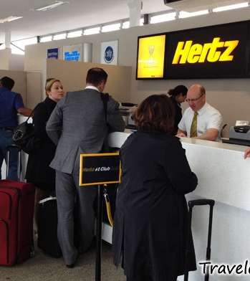
Strategy 3: Raising Airport Rates
This Photo by Unknown Author is licensed under CC BY-NC-ND
Notes:
This strategy considers Lariat locations in Airports. In general, if a car rental company is in an airport, it can charge higher rates due to the demand that passengers may have to acquire a vehicle after they land. The third strategy implements a 25% increase in rental fees. The baseline inventory does not change; however, it may mitigate some losses due to some instances of a rental grossing more income. While our friend, the 2018 Daewoo Nubira, is still at a net loss. It is approximately a $2900 loss instead of a $3300 loss. Also, just increasing fees by 25% at airport locations, only nine vehicles are at a net loss instead of 99 vehicles. Overall, the net profit is around 28.3 million. A gain of close to 6 million making this the most profitable strategy alone.
Also, Lariat has 22 airport locations out of the 50 total locations. Increasing the fees at these 22 locations will have an impact on bottom line. The demand for rental cars is higher at airports than at locations outside of them.

Slide 7
Combination Strategies
Strategy 1 & 3
Strategy 2 & 3
Notes:
While the third strategy is more profitable than the first two, I think it would be better combined using one of the other two previous strategies. The first combination considers replacing the bottom 10% of the vehicle inventory with the top 10% of vehicles focusing on an auto’s net profit and increasing the fees at airport locations by 25%. The latter combination focuses on how often each vehicle is rented instead of an automobile’s net profit. The first combination yields a net profit of almost 33 million, an increase of over 10 million from the baseline. The second combination’s net profit is slightly under 32 million, only a $9 million difference.
As the counts remain the same as implementing the first two strategies without changing the airport rental rate, the net income a vehicle will produce can change. Two examples are the 2016 Honda Civic having a net income of $116,000 combining strategies 1 and 3; and the 2018 Dodge Viper netting around $105,000 with the second combination, strategy 2 and 3.

Slide 8

Best Solution
Combine Strategies 1 & 3!!!
Notes:
With all the strategies presented, I would urge Lariat to go with the combination of the replacing the bottom 400 underperforming vehicles with the top 400 vehicle models that are producing the best net income in addition to increasing the fees at airport locations by 25%. To review, using the first strategy, every automobile made a positive net profit of at least $1800. Also, the demand is higher for people to rent cars at airports. Using these two strategies alone, considering Lariat receives the same amount of business, the company’s net profit increases by over $10 million dollars.

Slide 9

Questions
Notes:
Anybody have any questions?

